Slide 1
Bumper Buster
John Garcia, Terri Jackson, Michelle Zokou, David Onyenuforo

Slide 2
New York
Recently, there has been reportings of vehicular related accidents in New York. Gov. Jackson is looking for ways to help alleviate issues in the midst of an upcoming election.
As part of her data science team, we were to analyze and interpret the collision data from 2015-2017.
Provide solutions and recommendations to understand the problem.
Also, analyze our data to find a way to improve on the Vision Zero implementation.

Slide 3
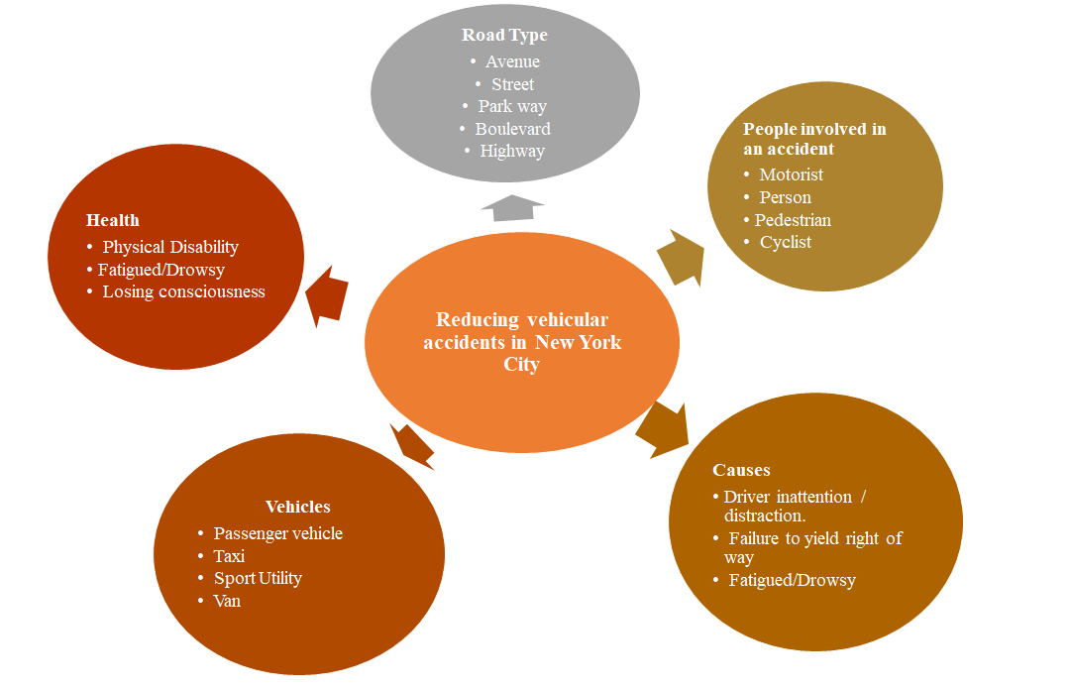

Slide 4
Inquiries Formulated
Based on the data the questions we formulated were:
“ Which Borough Has the Highest Frequency of Accidents?”
“ What Were Main Causes of the Accidents?”
“ What Time Did Most of The Accidents Occur?”
Question We Wanted to Ask:
“ How Old Were the Drivers?”
“ What is the Gender of the Persons Involved in the Accident?”
“What Were the Conditions of the Road?”
Notes:
=

Slide 5
Original Variables | Final Variables
Unique ID | ☑
Date | ☒
Time | ☑
Borough | ☑
Zip code | ☑
Latitude | ☒
Longitude | ☒
Location | ☒
On street | ☑
Cross Street | ☒
Off street | ☒
Vehicle type 1,2,3,4,5 | ☑ Vehicle 1,2,3
Vehicle factor 1,2,3,4,5 | ☑ Vehicle factor 1,2,3
Person injured & Killed | ☑
Pedestrian injured & killed | ☑
Cyclist injured & killed | ☑
Motorist injured & killed | ☑
☒= Removed
☑= Kept

Slide 6
Problems w/ the Data Set
Originally, the data set contained 477,732 . It included many empty zip codes, empty borough fields, empty time fields, etc. As well as, duplicates that contained data more than once. We had to clean the data by getting rid of the ambiguous data using queries. After wrangling the data the final amount of accident data were: 237,968

Slide 7
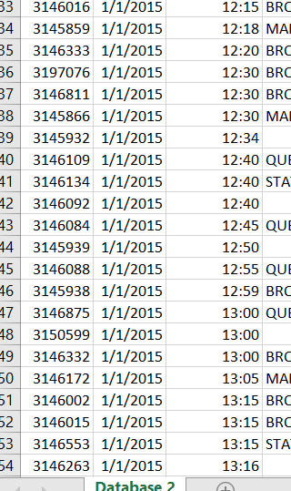
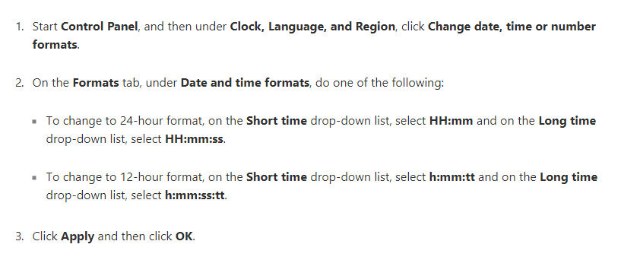
Problems with the Data Set
Time Conversion
Originally, the data set variable TIME, was in military time. We converted it to the standard 12hr clock

Slide 8
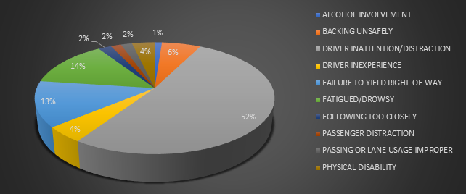
Main Causes of Accidents

Slide 9
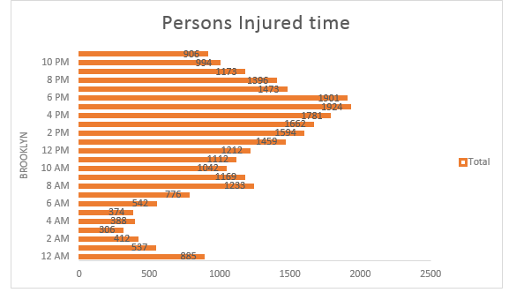
Time of The Accidents

Slide 10
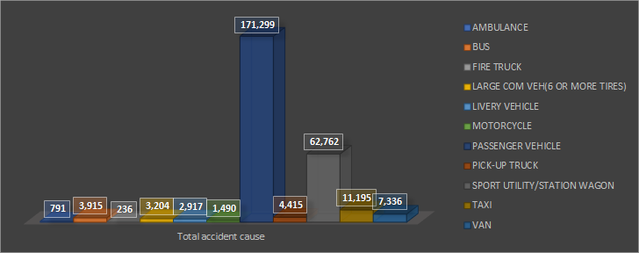
Vehicles Involved in Accidents
Figure

Slide 11
Recommendations/ Future Recommendation
According to Our Findings What We Propose Are:
Focus on Drivers Residing in Brooklyn.
Target Drivers who Driver Passenger Vehicles (SUV, Sedans, Pick Up)
Target Drivers driving from times 3:00-6:00 PM (Most Accidents Happen during Rush Hour)
Raise Awareness Against Driver Inattention/ Distractions
Future Recommendations:
Focus on drivers age in the target range
Notes:
According to the Cencus, Brooklyn has the highest population of 2.6 Million. With queens coming in to 2.3 Million

Slide 12
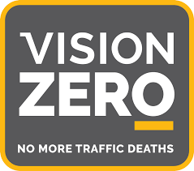
What is Vision Zero?
Vision Zero was a road safety project that was started in Sweden in 1997.
Vision Zero is based on the principle that "it can never be ethically acceptable that people are killed or seriously injured when moving within the road transport system.”
Vision Zero projects includes reducing speed
limits, creating training programs for drivers,
adding crash barriers and much more.

Slide 13
Recommendations ( Vision Zero)
Vision Zero is not just in NY, but in, Washington D.C., San Diego, Chicago, London and many more.
Vision Zero has helped to reduce the number of casualties and fatalities on the roads everywhere it has been implemented.
The implementation may include reducing speed limits, reconstructing intersections, creating training courses for drivers with a history, adding road barriers, cycling lanes and much more.
Vision Zero work with the highest ranking local officials, to discuss new local policies and how the budgets can be used to improve the overall road safety.

Slide 14
Top 5 Things We Learned
Data analysis can take a long time.
Data is never clean.
You will spend your time cleaning and preparing the data .
No one cares how you get the data, but the outcome of it and its end use.
Not everything is automated, you have to get your hands dirty.

